Slide 1
Sentiment And Sentiment Analysis
Sentiment analysis (aka opinion mining) refers to the use of natural language processing, text analysis and computational linguistics to identify and extract subjective information in source materials.
In other words it is the process of detecting the contextual polarity of text to find whether a piece of writing is positive, negative or neutral.
Sentiment comes from Feelings (Emotion, Opinion)
Emotion ( Joy, Sadness, Anger, Fear, Surprise, Disguise )
Opinion ( A binary opposition, Good/Bad, Like/Dislike, For/Against)
Sentiment Analysis is conducted using Non-Linear programming (NLP), Statistics or Machine Learning method to extract & identify the pattern of human sentiment and to characterize the sentiment behind the text unit.
Text mining and finding out the emotion or opinion of the text unit is the common practice for Sentiment Analysis and often used in Call Center data, Reviews, Twitter extracts etc.

Slide 2
Process Flow & Categorization
Process Flow:
Identify the source of data
Establish the connection with the source using authentication methods
Extract the data in the form of text, voice converted to text, image mapped to data form etc. Common data sources includes Twitter extracts, FB posts, Comments and Reviews on multiple sites etc.
Perform Sentiment analysis using specified techniques
Analyze and Present results as per business needs
Categorization Methods:
Data Driven- Key word/ phrase Identification
Smiley Recognition
Likes Count
Rating count method

Slide 3
Techniques and Functions of Sentiment Analysis
Techniques:
Classification of emotions
Polarity of words
Text based sentiment classification
Incorporate shallow linguistic/heuristic
Functions:
classify_emotion()
classify_polarity()

Slide 4
Functions of Sentiment Analysis
Functions:
classify_emotion(textColumns,algorithm="bayes",prior=1.0,verbose=FALSE,...)
Part of Sentiment package.
Classifies the emotion (e.g. anger, disgust, fear, joy, sadness, surprise) of a set of texts using a naive Bayes classifier trained on specified emotions lexicon.
Arguments
textColumns - A dataframe of text documents listed one per row.
Algorithm - A string indicating whether to use the naive bayes algorithm or a simple voter algorithm.
Prior - A numeric specifying the prior probability to use for the naive Bayes classifier.
Verbose - A logical specifying whether to print detailed output regarding the classification process.
Additional parameters to be passed into the create_matrix function.
Values
Returns an object of class dataframe with seven columns and one row for each document.

Slide 5
Functions of Sentiment Analysis-Contd…
Functions:
classify_polarity(textColumns,algorithm="bayes",pstrong=0.5,pweak=1.0,prior=1.0,verbose=FALSE,...)
Part of Sentiment package.
Classifies the polarity (e.g. positive or negative) of a set of texts using a naive Bayes classifier trained on Janyce Wiebe's subjectivity lexicon
Arguments
textColumns - A dataframe of text documents listed one per row.
Algorithm - A string indicating whether to use the naive bayes algorithm or a simple voter algorithm.
Pstrong/Pweak -A numeric specifying the probability that a strongly/weakly subjective term appears in the given text.
Prior - A numeric specifying the prior probability to use for the naive Bayes classifier.
Verbose - A logical specifying whether to print detailed output regarding the classification process.
Additional parameters to be passed into the create_matrix function.
Values
Returns an object of class dataframe with four columns and one row for each document.

Slide 6
Steps Used for Performing Twitter Data Sentiment Analysis
Load necessary R packages
Create twitter App to get consumer key and consumer secret key
Establish R and twitter connection for searching the required tweets
Extract tweets containing the desired term
Prepare the text for sentiment analysis of tweets
Performing Sentiment Analysis
Create data frame with the results and obtain some general statistics
Plotting to view results

Slide 7
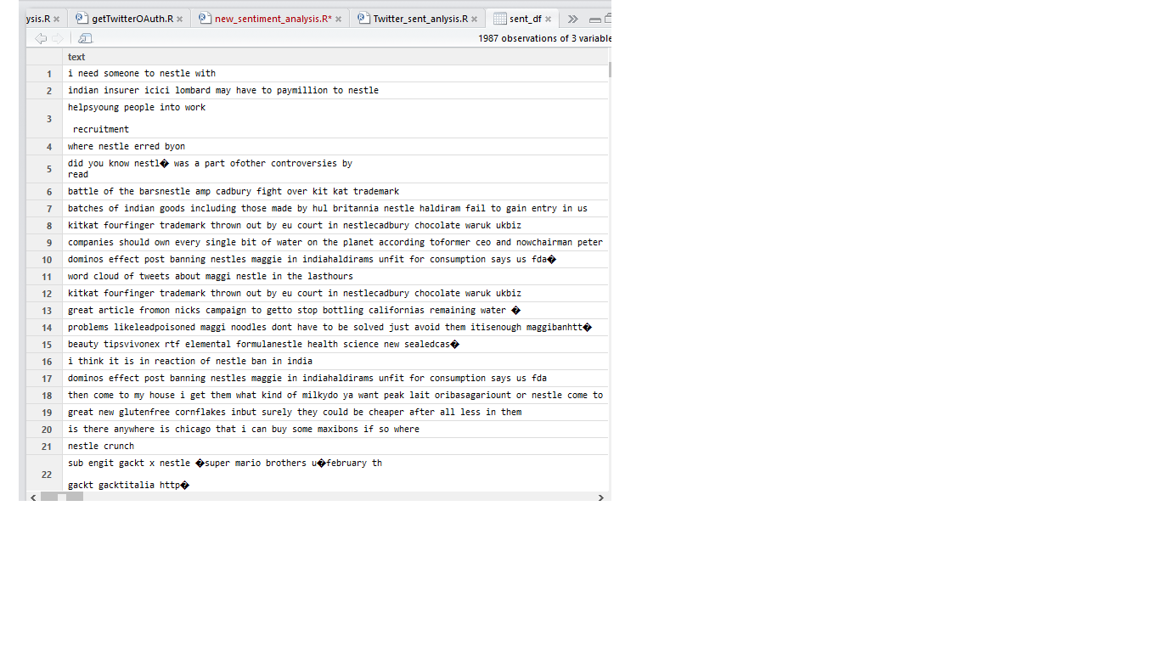
Sample Data Snapshot – Nestle Tweets as downloaded

Slide 8
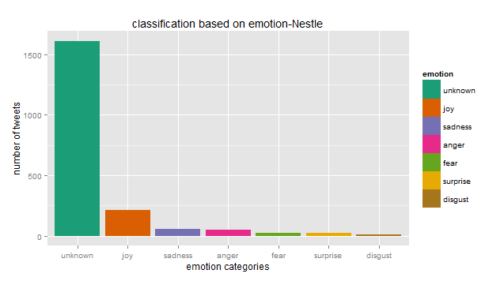
Output-Emotions Cloud in the tweets

Slide 9
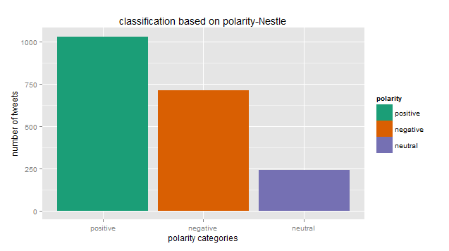
Output-Polarity Cloud in the tweets

Slide 10
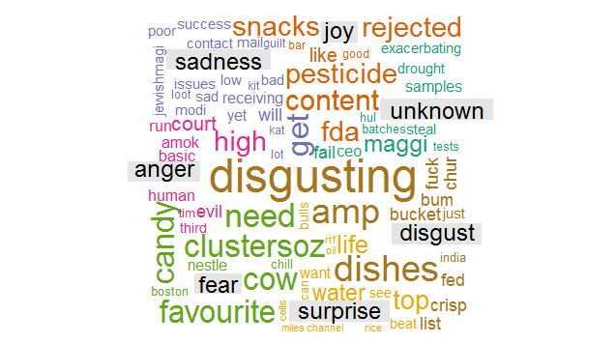
Words Dispersion on Cloud in the tweets

